Slide 1


THE BASIC CONCEPTS PROGRAMME (BCP)
A PROJECT FOR THE KWENA BASIN EDUCATION TRUST
(2014 -2018)
A programme developed by Dr. Louis Benjamin
E: louisben@iafrica.com W: www.basicconcepts.co.zo C: 084 857 8763

Slide 2
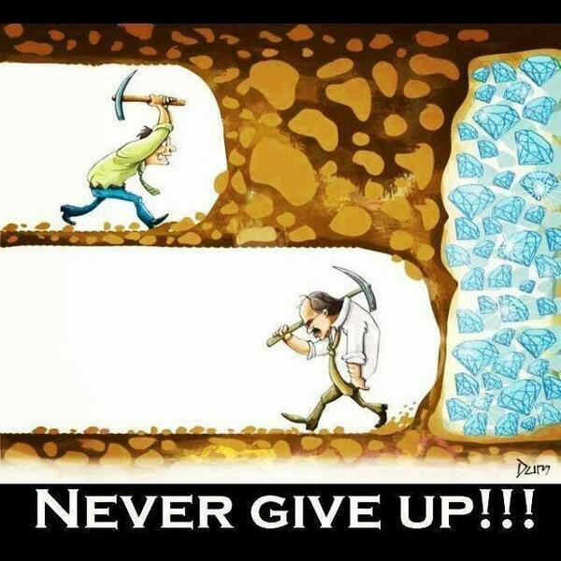

Slide 3


A BASIC CONCEPTS PROJECT for
THE KWENA BASIN EDUCATION TRUST
How much talk is there between
the learners and teacher:
1----2----3----4-----5
1= Very little to none
2= Little, mainly one way teacher talk and repetition
3=Some, the teacher mainly asks the questions and the learners try to answer (not always in full sentences)
4= A lot, the learners start to initiate talk and ask questions –there is a back and forth talk between learners and the teacher
5 = High levels of talk and use of conceptual language all the time

Slide 4
A BASIC CONCEPTS PROJECT for
THE KWENA BASIN EDUCATION TRUST
Guide to interpret total score
21-24 = good to very good
18-20 = average
11-17 = *weak
0-10 = *very weak (*intervention recommended)

Slide 5
A BASIC CONCEPTS PROJECT for
THE KWENA BASIN EDUCATION TRUST
Guide to interpret total score
21-24 = good to very good
18-20 = average
11-17 = *weak
0-10 = *very weak (*intervention recommended)

Slide 6
A BASIC CONCEPTS PROJECT for
THE KWENA BASIN EDUCATION TRUST
Guide to interpret total score
21-24 = good to very good
18-20 = average
11-17 = *weak
0-10 = *very weak (*intervention recommended)

Slide 7
A BASIC CONCEPTS PROJECT for
THE KWENA BASIN EDUCATION TRUST
Guide to interpret total score
21-24 = good to very good
18-20 = average
11-17 = *weak
0-10 = *very weak (*intervention recommended)

Slide 8
A BASIC CONCEPTS PROJECT for
THE KWENA BASIN EDUCATION TRUST
Notes:
2014 = 18 learners (1+6+11 in Grade 3)
2015 = 74 learners (20+23+31)

Slide 9
A BASIC CONCEPTS PROJECT for
THE KWENA BASIN EDUCATION TRUST
BASIC CONCEPTS PROGRAMME 2016
Term 1 | Conceptual Domain | Number of Weeks
January -February | Colour | 7
March | Colour | 3
Term 2 | Conceptual Domain | Number of Weeks
April - May | Shape | 6
May - June | Size | 6
Term 4 | Conceptual Domain | Number of Weeks
October - December | Number + Letter | 9
Term 3 | Conceptual Domain | Number of Weeks
July - August | Position | 6
August - September | Number + Letter | 5

Slide 10
A BASIC CONCEPTS PROJECT for
THE KWENA BASIN EDUCATION TRUST
Implementing the BASIC CONCEPTS in 2016
Grade R and Grade 1
*All learners receive intervention: 3/4 times per week x 15min
*Break your class into a maximum of three groups: discuss how to
form these groups + refer to notes in training file
*Write up the names of the learners on the BC Register –Inside sleeve
*Fill in the BCs Implementation Planner – Inside sleeve

Slide 11
A BASIC CONCEPTS PROJECT for
THE KWENA BASIN EDUCATION TRUST
Implementing the BASIC CONCEPTS in 2016
Grade 2, Grade 3 and Grade 4 at Umthombo
*Learners who have been identified by the Test BCs Knowledge
receive intervention: 3 times per week x 15min
*Break your class into a maximum of three groups: See list of
learners inside your plastic sleeve
*Write up the names of the learners on the BC Register – Inside sleeve
*Fill in the BCs Implementation Planner – Inside sleeve

Slide 12
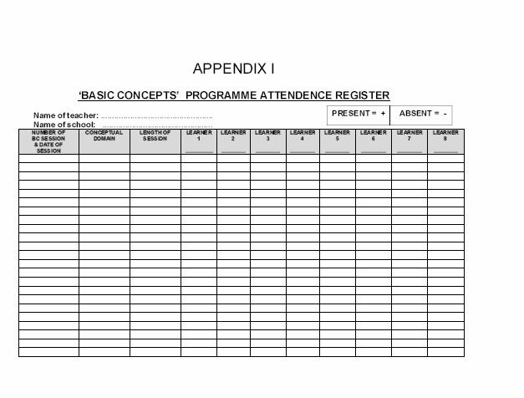
ATTENDANCE REGISTER
Basic Concepts Manual: p.99

Slide 13
Basic Concepts Programme (2016)
Name of school: ……………………………….
Name of teacher: ……………………………..
Grade/s: _____
Group 1
Group 2
Group 3
Number of learners
__________________
Intervention Session 1
Day:______Time_____
Intervention Session 2
Day:______Time_____
Intervention Session 3
Day:______Time_____
Number of learners
__________________
Intervention Session 1
Day:______Time_____
Intervention Session 2
Day:______Time_____
Intervention Session 3
Day:______Time_____
Number of learners
__________________
Intervention Session 1
Day:______Time_____
Intervention Session 2
Day:______Time_____
Intervention Session 3
Day:______Time_____
***The length of intervention sessions = 15 minutes

Slide 14
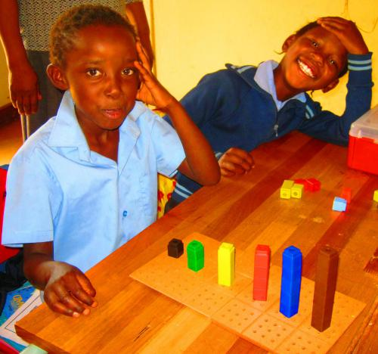

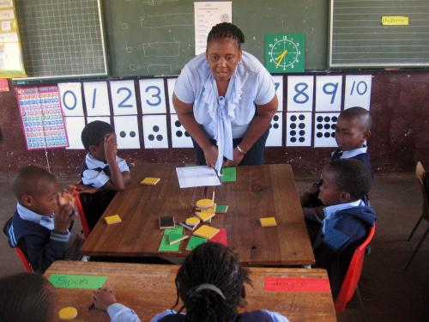
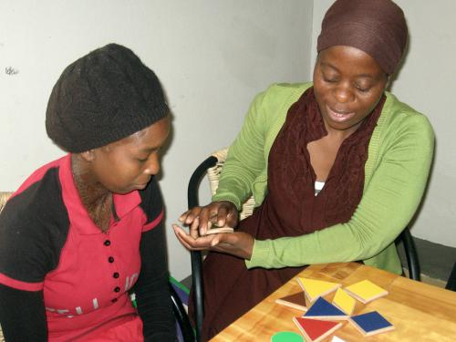
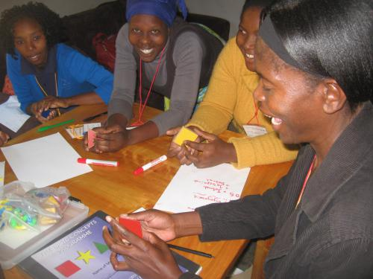
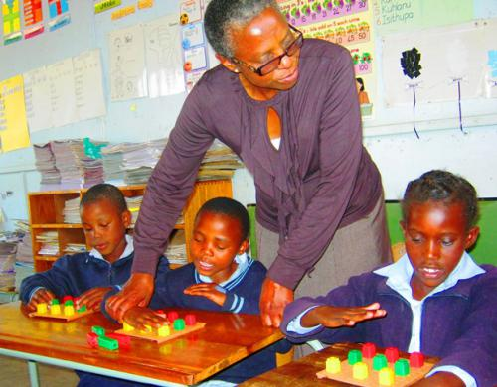
A BASIC CONCEPTS PROJECT for
THE KWENA BASIN EDUCATION TRUST
Notes:
2014 = 18 learners (1+6+11 in Grade 3)
2015 = 74 learners (20+23+31)

